Slide 1
Proportion difference and confidence interval based on CMH test in stratified RCT with an example in pooled analysis of HIV trials
Jacob Gong

Slide 2
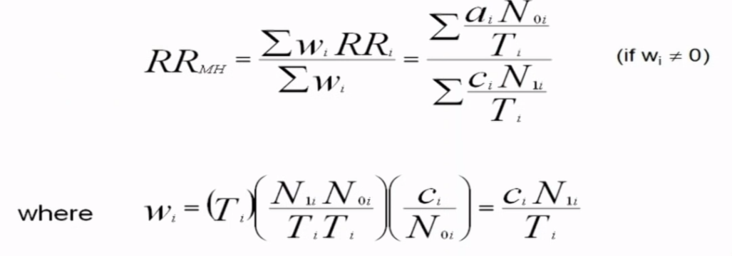
Mantel-Haenszel estimators for adjusted RR
Cumulative incidence (Risk) data
 | Disease + | Disease - | Total
Exposure + | A | B | N1
Exposure - | C | D | N0
Total | A+C | B+D | T

Slide 3
Which table has more information?
 | D+ | D- | Total
E+
E-
Total |  |  | 1000
Table A
 | D+ | D- | Total
E+
E-
Total |  |  | 100
Table B

Slide 4
Which table has more information?
 | D+ | D- | Total
E+ |  |  | 999
E- |  |  | 1
Total |  |  | 1000
Table A
 | D+ | D- | Total
E+ |  |  | 50
E- |  |  | 50
Total |  |  | 100
Table B

Slide 5
Which table has more information?
 | D+ | D- | Total
E+ |  |  | 500
E- | 100 |  | 500
Total |  |  | 1000
Table A
 | D+ | D- | Total
E+ |  |  | 500
E- | 10 |  | 500
Total |  |  | 1000
Table B

Slide 6
Cochran-Mantel-Haenszel Estimates - Example
 | Age < 50 |  |  | Age >= 50
 | CVD | No CVD | Total | CVD | No CVD | Total
Males | 14 | 1502 | 1516 | 76 | 873 | 949
Females | 10 | 1691 | 1701 | 121 | 2124 | 2245
Total | 24 | 3193 | 3217 | 197 | 2997 | 3194
Crude RR =(90/2465)/(131/3946)=1.10
RR age<50 =(14/1516)/(10/1701)=1.57
RR age50+ =(76/949)/(121/2245)=1.49

Slide 7
Adhoc analysis of pooled HIV study
Snapshot table of pooled study data of HIV trials
Binary response
HIV-1 RNA < 50 copies/mL
HIV-1 RNA >= 50 copies/mL
Four treatment arms across study
Stratification factors:
baseline HIV-1 RNA (<=100K vs >100K)
baseline CD4 (<200 cells vs >=200 cells/uL)
region (US vs ex-US)
adherence rate (<90% vs >= 90 %)
Strata-adjusted proportion difference obtained by Cochran-Mantel-Haenszel (CMH) method.

Slide 8
Treatment difference (95 CI) CMH test in SAS
No SAS option in PROC FREQ to produce strata-adjusted proportion difference from CMH method. At Gilead, we use %tabsamhp
Response | Treatment | Control | Total
Yes | X1j | X0j | Xj
No | n1j-x1j | n0j-x0j | Nj-Xj
Total | n1j | n0j | Nj
each stratum j

Slide 9
Using 4 stratification factor
Macro produce difference in percentages between treatments but fail to produce 95%CI, p-value, why?
There are many small or missing stratum

Slide 10
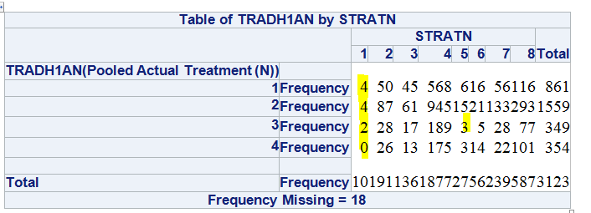
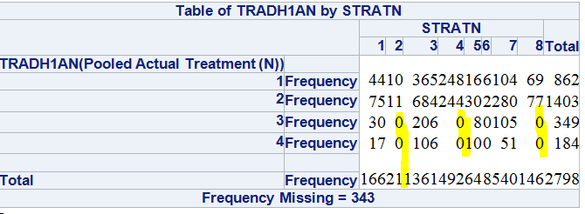
How many stratification factor is too many?
Scenario 1
baseline HIV-1 RNA (<=100K vs >100K)
baseline CD4 (<200 cells vs >=200 cells/uL)
adherence rate (<90% vs >= 90 %)
Scenario 2
baseline HIV-1 RNA (<=100K vs >100K)
region (US vs ex-US)
adherence rate (<90% vs >= 90 %)

Slide 11
Prevent small or missing stratum
Final selection of stratification factor
baseline HIV-1 RNA (<=100K vs >100K)
adherence rate (<90% vs >= 90 %)
Exclude stratum
HIV-1 RNA level and CD4+ cell count highly correlated
a balanced region distribution between treatment groups is expected
Reclassify stratum
N of subjects in the HIV-1 RNA > 400,000 copies/mL stratum is small
Reclassify to a 2-level HIV-1 RNA stratum (≤ 100,000 vs. > 100,000 copies/mL)

Slide 12
Lesson learnt
CMH test
For CMH test to be valid, the sample size should be relatively large in each stratum.
Check to make sure enough statistical power for CMH test to provide meaningful treatment difference and 95%CI
Prevent small or missing stratum
Exclude stratum
Reclassify stratum

Slide 13
Acknowledgement
Yu Ning, Associated Director, Statistical Programming, Gilead Science
Ting Bai, Associated Director, Statistical Programming, Gilead Science
Dayakar Gouru, Senior Statistical Programmer, Gilead Science

Slide 14
Reference
Confounding and Effect Measure Modification Wayne W. LaMorte, MD, PhD, MPH, Professor of Epidemiology, Lisa Sullivan, PhD, Professor of Biostatistics, Boston University School of Public Health

